Slide 1
🏥 ADVANCED HEALTHCARE INTELLIGENCE
DIAB CARE ANALYTICS
Clinical Risk Stratification, Predictive Analytics & Patient Registry Platform
An executive Power BI presentation simulating multi-factor diabetes risks, patient cohort dynamics, metabolic biomarkers, and machine-learning key influencers.
COHORT SIZE
DIABETIC COHORT
PREDIABETIC AT-RISK
HIGH RISK SEVERE
AVG GLUCOSE / BMI
768
268
201
148
122 / 32.4
Total Monitored
34.9% Prevalence
Intervention Window
Critical Triage
Elevated Baseline
Prepared for: Clinical Care Team & Executive Leadership | Platform: Power BI Embedded Interactive Suite | Data Cycle: 2026-10 | Classification: Clinical Audit Standard

Slide 2
EXECUTIVE ARCHITECTURE
Four Strategic Pillars of Diab Care Intelligence
01 • PRE-CLINICAL TRIAGE
02 • EPIDEMIOLOGY MATRIX
03 • PATHOPHYSIOLOGY
04 • AI DECISION SUPPORT
🫀
📊
🔬
📋
Welcome & Wellness
Population Overview
Clinical Deep-Dive
Patient Registry
Continuous digital biometric tracking capturing real-time physiological status before invasive clinical diagnostics.
Broad cohort demographic profiling mapping diabetes prevalence across blood pressure, glucose classes, and parity tiers.
In-depth endocrine kinetics examining age-related hyperinsulinemia, subcutaneous fat failure, and genetic predisposition.
Machine learning explainable AI (XAI) uncovering key influencers and decision trees for targeted clinical prevention.
▸ Heart Rate Stability Score: 82% (72 BPM)
▸ Sleep Quality 7-day tracking (Avg 78%)
▸ Physical activity & intensity mapping
▸ Weekly movement trend: 45,780 steps (+18%)
▸ Total cohort size: 768 registered patients
▸ 34.9% overall diabetes rate (268 cases)
▸ Obesity class multiplier: 45.8% prevalence
▸ Gestational parity peak: 56.2% for 3-5 births
▸ Skin fold thickness across BMI categories
▸ Insulin & Genetic risk peak at age 50-59 (183 µU/mL)
▸ Bivariate scatter: Glucose vs BMI clustering
▸ Multi-tier risk matrix (BMI × Blood Pressure)
▸ Key Lever: Glucose drop (-30.44 -> 1.87x non-diabetic)
▸ BMI reduction lever (-6.88 -> 1.51x protective boost)
▸ 148 High-Risk pool (75.7% currently non-diabetic!)
▸ Decomposition tree: 82.5% obesity concentration
DIAB CARE ANALYTICS DASHBOARD | CLINICAL RISK STRATIFICATION & HEALTH INFORMATICS
POWER BI HEALTHCARE EDITION • CONFIDENTIAL

Slide 3
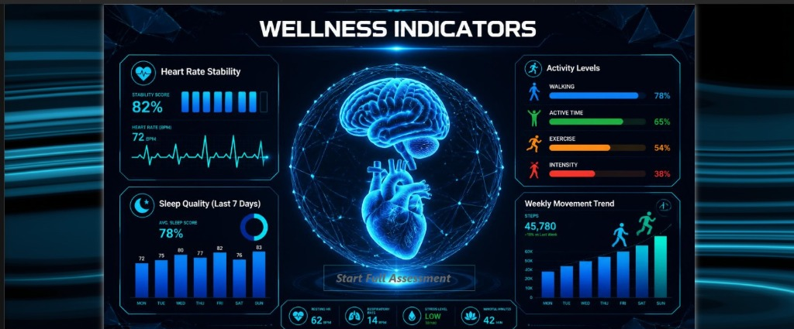
🍎 Diab Care Analytics Dashboard
Welcome
Overview
Clinical Deep-Dive
Patient Registry
🕒 2026-10-16 09:31 PM
CARDIOVASCULAR TELEMETRY • 82% Score | 72 BPM
Heart Rate Stability
Live sensor tracking reflects 82% heart rate stability with a 72 BPM baseline and normal sinus rhythm. Autonomic stability provides vital context on sympathetic stress.
CIRCADIAN HOMEOSTASIS • 78% 7-Day Average
Sleep Architecture
7-day continuous sleep monitoring shows stable scores (72% Monday climbing to 83% Sunday). Adequate sleep hygiene is essential to prevent acute morning insulin spikes.
EXERCISE PROTOCOL • 45,780 Weekly Steps
Movement & Intensity Gap
Activity volume grew +18% week-over-week. While walking volume is strong at 78%, exercise intensity lags at only 38%, highlighting a key lifestyle intervention target.
DIAB CARE ANALYTICS DASHBOARD | CLINICAL RISK STRATIFICATION & HEALTH INFORMATICS
POWER BI HEALTHCARE EDITION • CONFIDENTIAL

Slide 4
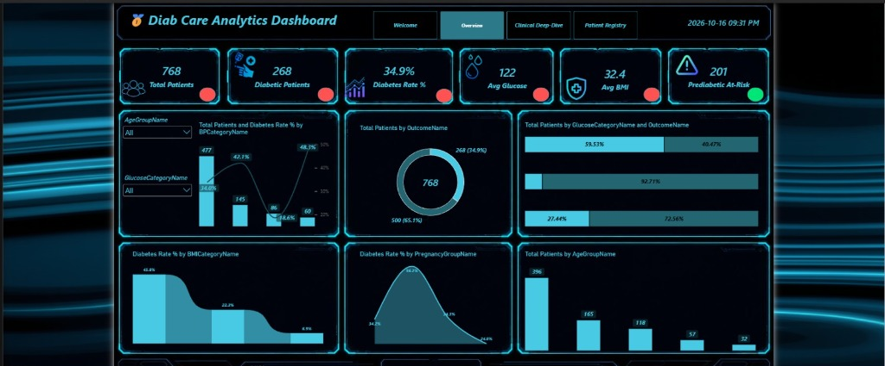
🍎 Diab Care Analytics Dashboard
Welcome
Overview
Clinical Deep-Dive
Patient Registry
🕒 2026-10-16 09:31 PM
👥
768
🩸
268
📈
34.9%
💧
122
🛡️
32.4
⚠️
201
Total Patients
Diabetic Patients
Diabetes Rate %
Avg Glucose
Avg BMI
Prediabetic At-Risk
COHORT METRIC • 34.9%
Epidemiological Outcomes
Donut analysis shows 500 non-diabetics (65.1%) and 268 confirmed diabetics. Prediabetic at-risk group totals 201 patients, representing the key prospective cohort.
METABOLIC ACCELERATOR • 45.8%
BMI Escalation Curve
Continuous area chart confirms obesity (BMI 30+) is the primary driver of diabetes. Risk drops to 22.2% in overweight (25-29.9) and to 6.9% in normal weight.
GESTATIONAL PROFILE • 56.2%
Parity & Age Profile
Pregnancy curve reflects clear gestational insulin resistance peak at 3-5 pregnancies. Cohort is demographically young with 396 patients in the 21-29 age bracket.
DIAB CARE ANALYTICS DASHBOARD | CLINICAL RISK STRATIFICATION & HEALTH INFORMATICS
POWER BI HEALTHCARE EDITION • CONFIDENTIAL

Slide 5
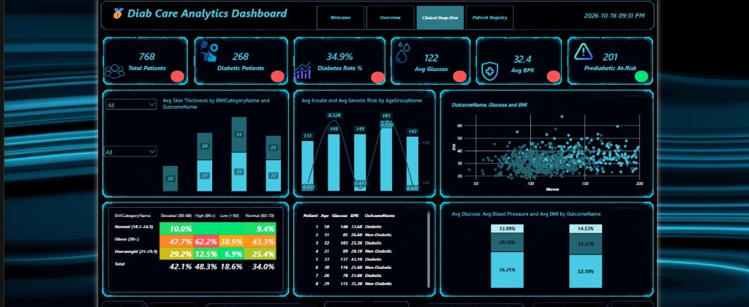
🍎 Diab Care Analytics Dashboard
Welcome
Overview
Clinical Deep-Dive
Patient Registry
🕒 2026-10-16 09:31 PM
👥
768
🩸
268
📈
34.9%
💧
122
🛡️
32.4
⚠️
201
Total Patients
Diabetic Patients
Diabetes Rate %
Avg Glucose
Avg BMI
Prediabetic At-Risk
ENDOCRINE KINETICS • 183 µU/mL
Age 50-59 Insulin Spike
Peak hyperinsulinemia occurs in the 50-59 age group (183 µU/mL) coupled with maximum genetic pedigree (0.529). Beta-cell exhaustion triggers after this decade.
PATHOLOGY CLUSTER • Critical Quadrant
Bivariate Glucose-BMI Scatter
Scatter analysis reveals sharp clustering of diabetic cases in the Glucose > 130 mg/dL and BMI > 32 kg/m² quadrant, separating clearly from the normoglycemic cluster.
ADIPOSE MARKER • 34 mm vs 21 mm
Subcutaneous Lipid Overflow
Skin fold thickness peaks at 34 mm in obese non-diabetics vs 21 mm in obese diabetics. Failure of peripheral subcutaneous storage forces toxic visceral fat deposition.
DIAB CARE ANALYTICS DASHBOARD | CLINICAL RISK STRATIFICATION & HEALTH INFORMATICS
POWER BI HEALTHCARE EDITION • CONFIDENTIAL

Slide 6
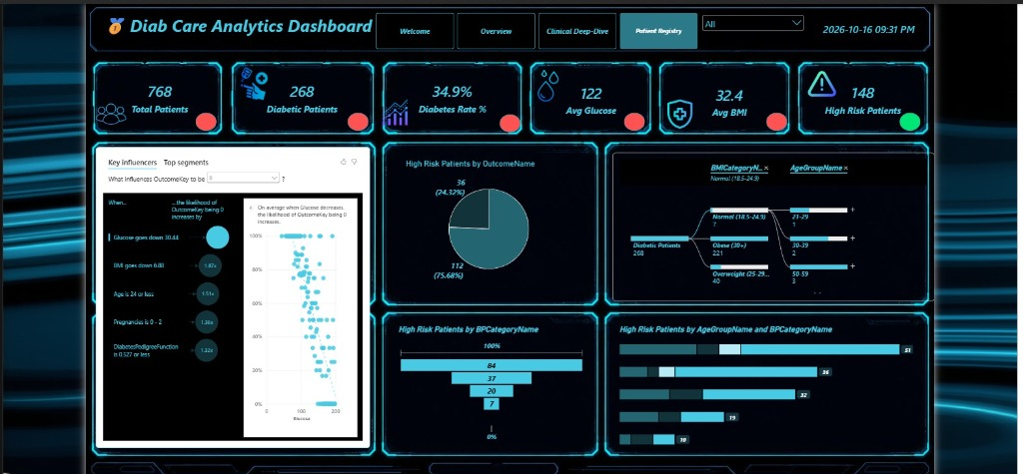
🍎 Diab Care Analytics Dashboard
Welcome
Overview
Clinical Deep-Dive
Patient Registry
🕒 2026-10-16 09:31 PM
👥
768
🩸
268
📈
34.9%
💧
122
🛡️
32.4
⚠️
148
Total Patients
Diabetic Patients
Diabetes Rate %
Avg Glucose
Avg BMI
High Risk Patients
MACHINE LEARNING XAI • 1.87x Multiplier
AI Key Influencers
Dropping Glucose by 30.44 mg/dL increases non-diabetic likelihood by 1.87x. Dropping BMI by 6.88 kg/m² adds another 1.51x protective boost. Age <= 24 gives 1.36x.
INTERVENTION OPPORTUNITY • 112 / 148 Patients
The 75.7% Prevention Window
Critical revelation: 112 out of 148 High-Risk patients (75.7%) are NOT yet diabetic. They represent the highest-ROI opportunity for aggressive clinical lifestyle intervention.
82.5% CONCENTRATION • 221 Obese Diabetics
Decomposition Tree Insight
Decomposition tree reveals 221 of 268 confirmed diabetics are obese (30+ BMI). Targeting obesity in this single group neutralizes the vast majority of diabetic disease burden.
DIAB CARE ANALYTICS DASHBOARD | CLINICAL RISK STRATIFICATION & HEALTH INFORMATICS
POWER BI HEALTHCARE EDITION • CONFIDENTIAL

Slide 7
STRATEGIC INTERVENTION FRAMEWORK
Stratified Clinical Protocols & Executive Roadmap
TIER 1: HIGH RISK & CONFIRMED DIABETIC
✔ Deploy Continuous Glucose Monitoring (CGM) for all 148 high-risk cases.
✔ Targeted glycemic reduction (>30.44 mg/dL drop to trigger 1.87x remission multiplier).
148 High Risk | 268 Confirmed Diabetics
Protocol: Immediate Pharmacotherapy & Tertiary Prevention
✔ GLP-1 receptor agonist and SGLT2i evaluation to address obesity (221 cases) and renal protection.
✔ Weekly multidisciplinary team review (Endocrinology, Cardiology, Dietetics).
TIER 2: PREDIABETIC AT-RISK COHORT
✔ Structured 16-week diabetes prevention program targeting 7% body weight reduction (6.88 kg/m² BMI drop).
✔ Postprandial glycemic excursions monitored via wearable patch telemetry.
201 Prediabetic Patients (The Golden Prevention Window)
Protocol: Aggressive Lifestyle Intervention & Metformin Interception
✔ Early Metformin therapy considered for age 50-59 cohort with peak insulin (183 µU/mL).
✔ Bi-monthly HbA1c testing and automated EHR risk re-scoring.
TIER 3: HIGH PEDIGREE & MULTIPAROUS WOMEN
✔ Annual oral glucose tolerance test (OGTT) for all multiparous women (3-5 pregnancies).
✔ Familial screening counseling for first-degree relatives of confirmed diabetic patients.
DiabetesPedigreeFunction > 0.527 | 3+ Pregnancies (56.2% risk cohort)
Protocol: Early Surveillance & Epigenetic Risk Mitigation
✔ Nutrition consultation emphasizing low glycemic index Mediterranean dietary pattern.
✔ Postpartum metabolic follow-up protocol established through primary care clinics.
TIER 4: GENERAL POPULATION WELLNESS COHORT
✔ Encourage physical activity maintenance above the 45,780 steps weekly baseline.
✔ Address exercise intensity gap (currently at only 38% vs 78% walking volume).
400+ Normoglycemic & Baseline Patients
Protocol: Digital Biomarker Tracking & Primary Prevention
✔ Promote sleep hygiene to maintain 7-day average score above 80% to protect insulin sensitivity.
✔ Annual biometric wellness checkup in the Diab Care Analytics portal.
DIAB CARE ANALYTICS DASHBOARD | CLINICAL RISK STRATIFICATION & HEALTH INFORMATICS
POWER BI HEALTHCARE EDITION • CONFIDENTIAL

Slide 8
👥 PROJECT PRESENTATION TEAM
Project Team Members
Diab Care Analytics Dashboard — Healthcare Intelligence & Predictive Modeling
👤 01
PROJECT TEAM MEMBER
👤 02
PROJECT TEAM MEMBER
👤 03
PROJECT TEAM MEMBER
Mohamed Mamdouh Abdelaty
Ahmed Awad Ahmed
Abdelrahman Mohamed Ahmed
👤 04
PROJECT TEAM MEMBER
👤 05
PROJECT TEAM MEMBER
Fatma Ahmed Abdul Qader
Yasmin Taha Alsayed
🎓 Department of Health Informatics & Data Analytics | Power BI Clinical Intelligence Project | October 2026
Thank You for Your Time! • Open for Questions, Clinical Discussion & Feedback

